Slide 1
Image Classification
import matplotlib.pyplot as plt
import matplotlib.image as mpimg
import numpy as np
from PIL import Image

Slide 2
Pixels
A pixel is the smallest little square that can be displayed on the screen or monitor.
A (raster-based) image is defined by an array of pixels with dimensions of width and height.
For example:
M x N pixels
X Direction
1
2
M
1
…
…
Y Direction
N

Slide 3
Accessing each pixel
import matplotlib.image as mpimg
img = mpimg.imread('sample_image.jpg')
pixel = img[x,y]
X Direction
1
2
M
1
x
y
For each pixel, we access by (x,y)
Y Direction
N

Slide 4
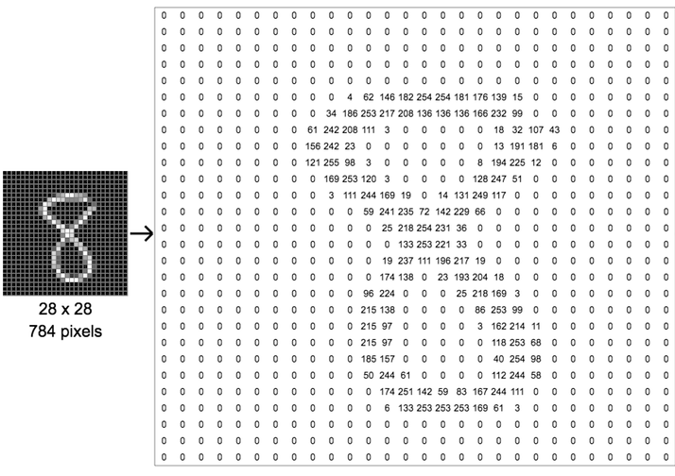
Pixel values (grayscale)
A grayscale image of M x N pixels is represented by an M x N array, each element representing the brightness of the pixel.
Pixel values:
Black: 0
White: 255
Gray: in between

Slide 5
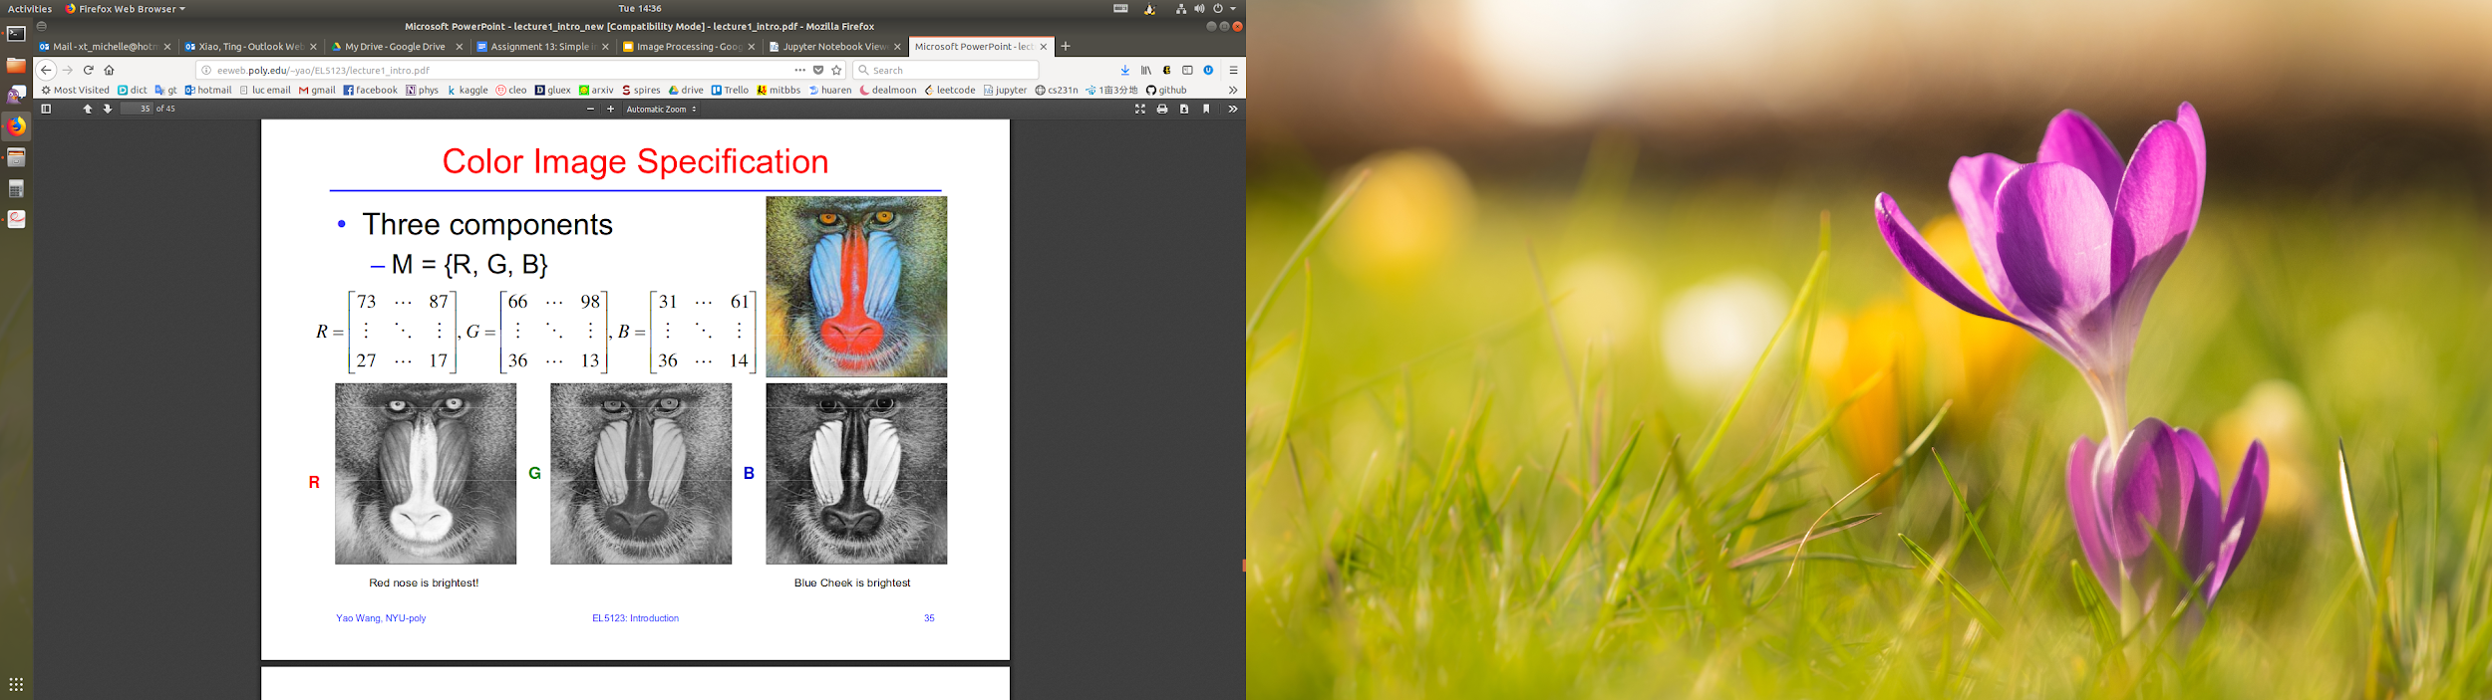
Pixel values (color)
A color image is represented by an M x N x 3 array.

Slide 6

Pixel values (color + transparency)
Some types of images are represented by M x N x 4 arrays, where the 4th number (alpha) defines the amount of transparency in the images.
alpha = 0
(opaque)
alpha = 1
(invisible)

Slide 7
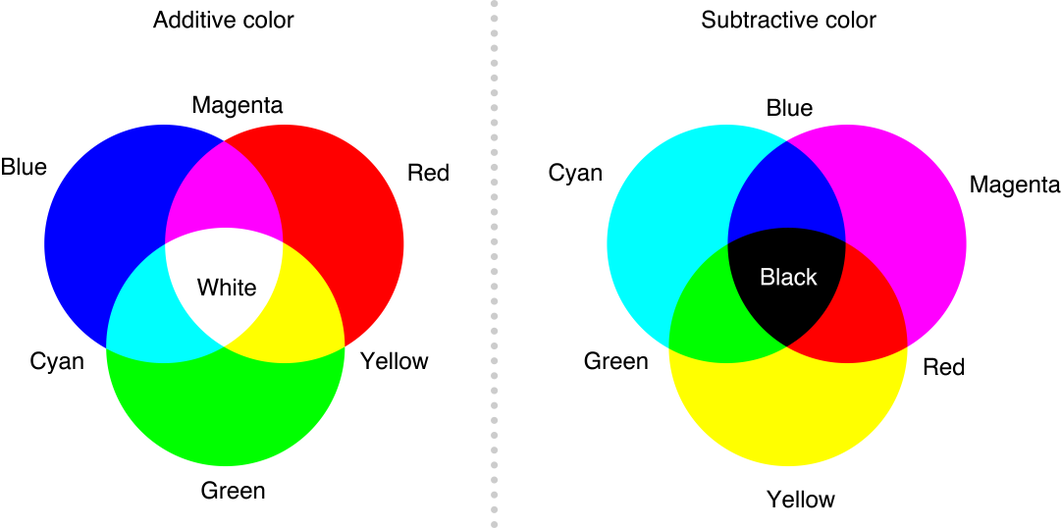
Additive vs subtractive colors
RGB values in defining pictures are additive colors, which behave differently in combination than mixing the same colors with paints (subtractive colors).

Slide 8
K-Nearest Neighbor Classifier
Bayes Classifier:
Error rate is minimized.
Assigns observations to a class based on predictor values.
Impossible to know clear boundary!
KNN classifier estimates
conditional distribution of Y=f(X)
Assign to class with highest estimated probability.

Slide 9
K-Nearest Neighbor Classification
CreativeCommons.org

Slide 10
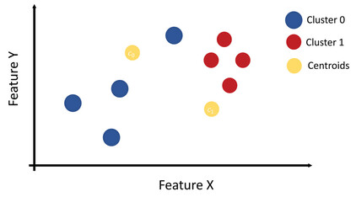
K-Nearest Neighbor Classification
CreativeCommons.org

Slide 11
Building Confusion Matrix
Chest Pain | Good Blood Circulation | Blocked Arteries | Weight | Heart Disease
Yes | No | No | 125 | No
No | Yes | Yes | 160 | Yes
Yes | Yes | No | 120 | No
ML Algorithm 1
142 | 22
29 | 110
ML Algorithm 2
107 | 53
64 | 79
Confusion Matrix for Heart Disease
Patients don’t have heart disease. But the ML algorithm predicted they do
ML algorithm correctly predicted that patients have heart disease
Has Heart Disease
Doesn’t have
Heart Disease
Rows: ML predicted
Has Heart Disease
True Positives | False Positive
False Negative | True Negative
Known Truth
Doesn’t have
Heart Disease
Patients didn’t have heart disease and as well the ML algorithm.

Slide 12
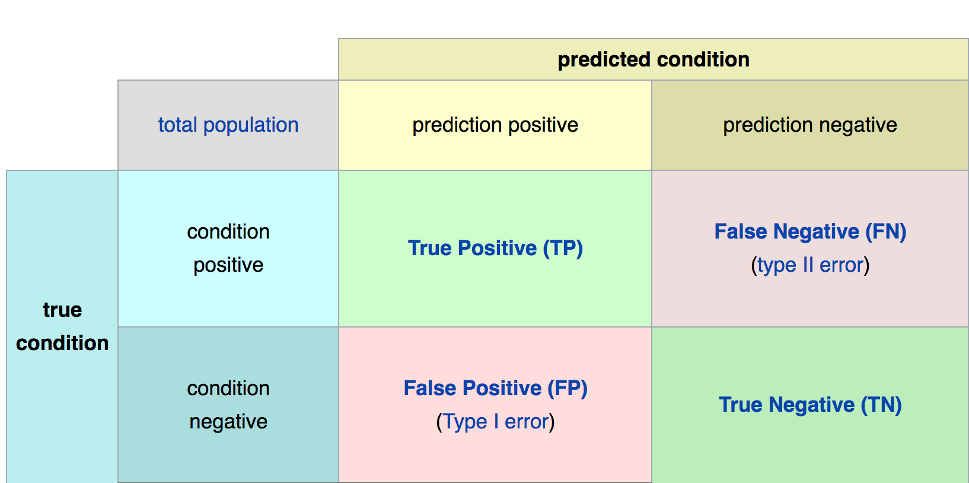
Confusion Matrix for Accuracy of Models
Machine Learning
Math &
Statistics
DS
Software
Research
Domain
Knowledge
“Diagnostic Testing Diagram is licensed under the CC BY-SA 3.0 Unported. All other content herein is licensed and copyright under different terms and by different parties.”

Slide 13
K-Nearest Neighbor Classification
No learning required
Model stores the entire dataset and classifies datapoints based on points in question
The prediction is based on training data only!
Algorithm:
Calculate the distance between data points.
Store distance array in ascending order (numpy argsort)
Select first k-elements in the sorted list
Use majority voting to classify new datapoint group.
Metric: Euclidian Distance
Get nearest neighbors
Make predictions

Slide 14
K-Nearest Neighbor Algorithm for Image Processing
Rows – Instance (aka sample) of your data (SKU in supply chain, people in population, image in images, etc.)
Columns - features (observation or attribute) of your data (SKUs: how many SKUs, what type of SKUs, People: sex, disease, height)
Target - what you are trying to get your system to predict (business intel, cost of care, etc.)
M-by-N matrix
feature
Label/Target
a1,1
a1,2
…..
a1,n
Y1
Y2
Y3
.
.
sample
a2,1
a2,2
a2,n
am,1
am,1
am,n
.
.
.

Slide 15
k-NN with images
Libs
import matplotlib.pyplot as plt; matplotlib.image as mpimg
from PIL import Image; import numpy as np
Create your classifier:
from sklearn import neighbors
k1 = neighbors.KNeighborsClassifier(n_neighbors=1, weights='distance')
Train your classifier:
k1.fit(training_data, training_target)
Predict the class of the test images:
k1_pred = k1.predict(test_data)
(Note: you need to put the test data into the standard form as well)

Slide 16
KNN with images
Follow our tutorials
Image processing
k-NN Classification

